Slide 1
Detection of Heart Disease using personal key indicators
RATHNAPRIYA GOPALAKRISHNAN
ALANKRIT GUPTA
JONAH ROCKEY
BALA AKHIL RAJDEEP BATTULA

Slide 2
Introduction
Heart disease is currently the leading cause of death in the United States today
Around 659,000 people die from heart related diseases every year in America, which is one in four deaths overall (CDC, 2021)
There are various factors which can lead to heart disease such as high blood pressure, smoking, obesity, and physical inactivity
Identifying the major risk factors will help us detect and treat heart disease in its early stages.

Slide 3
AIM
TO PREDICT WHETHER A PERSON WILL HAVE HEART DISEASE OR NOT USING VARIOUS RISK FACTORS.

Slide 4
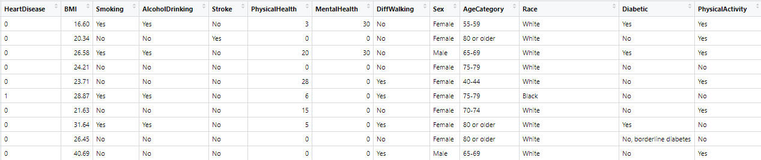
Data
Source: Kaggle
https://www.kaggle.com/datasets/kamilpytlak/personal-key-indicators-of-heart-disease
Number of records: 319796
Number of features: 18

Slide 5
Features
HeartDisease
BMI
Smoking
AlcoholDrinking
Stroke
PhysicalHealth
MentalHealth
DiffWalking
Sex
AgeCategory
Race
Diabetic
PhysicalActivity
GenHealth
SleepTime
Asthma
KidneyDisease
SkinCancer

Slide 6
Methodology
Data Cleaning
Data Exploration
Feature Engineering
Data Visualization
Sampling
Machine Learning
Evaluation

Slide 7
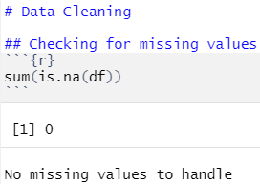
Data Cleaning
Since the Kaggle dataset is already pre-processed, we did not find any NULL values.

Slide 8
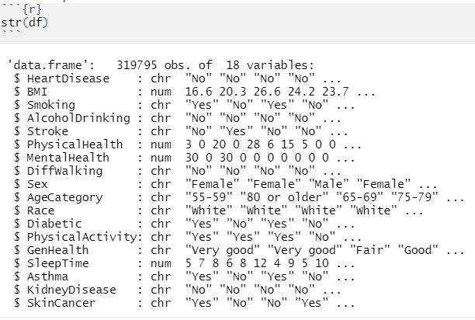
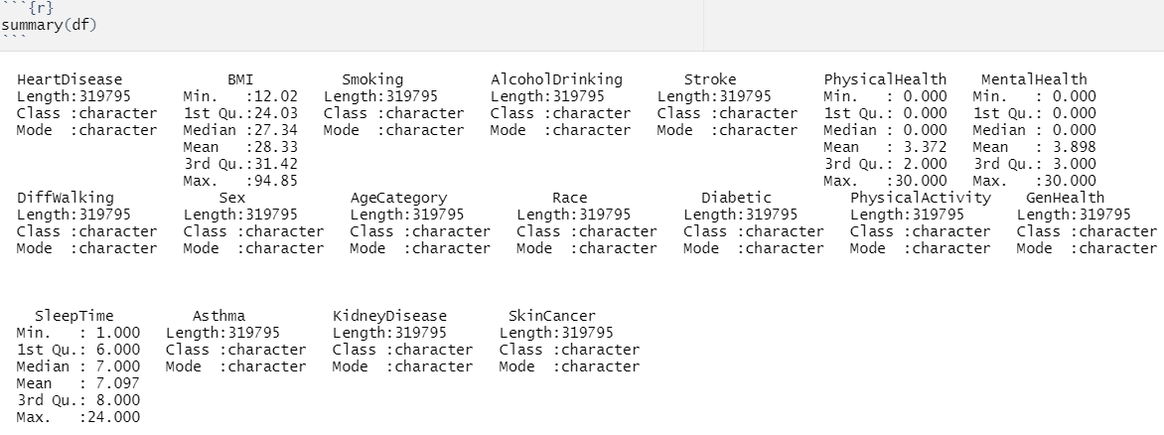
Data Exploration
We can see that the dataset contains a mixture of continuous and categorical variables.
Continuous variables: BMI, PhysicalHealth, MentalHealth, SleepTime
Categorical variables: HeartDisease, Smoking, AlcoholDrinking, Stoke, DiffWalking, Sex, AgeCategory, Race, Diabetic, PhysicalActivity, GenHealth, Asthma, KidneyDisease, SkinCancer

Slide 9
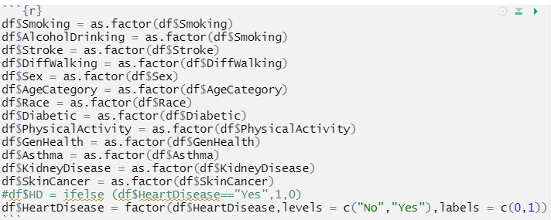
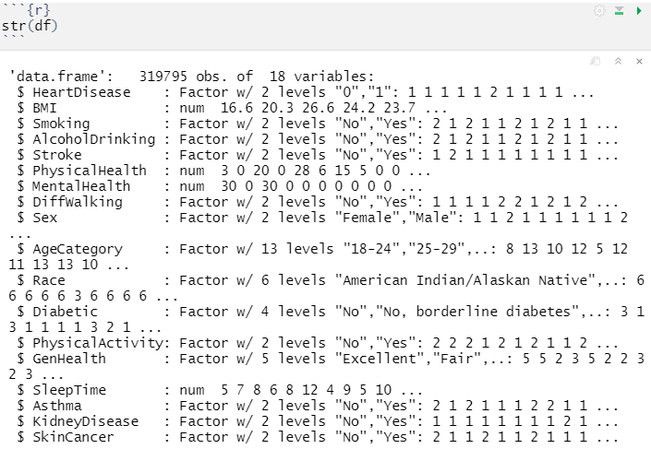
Feature Engineering
We will be converting the categorical variables to factors in R

Slide 10
Data Visualization

Slide 11
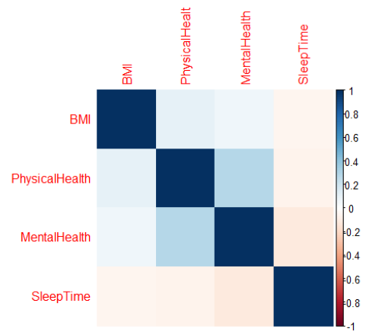
Corrplot
From the plot we can see that there no strong relationship between the continuous variables

Slide 12
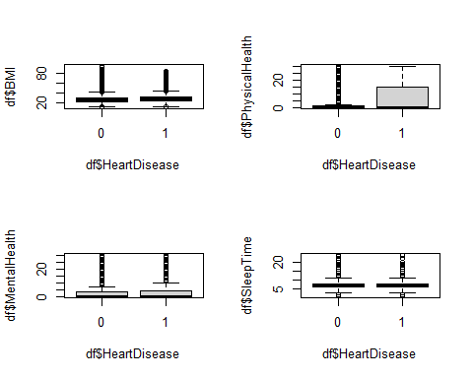
Box plots
We see that the box plot for Physical Health shows From the box plots we see a similar distribution for both heart disease and non heart disease patients for the following variables - BMI, MentalHealth and SleepTime
However, those with heart disease, experienced physical injuries or illness for higher number of days than those without heart disease.

Slide 13
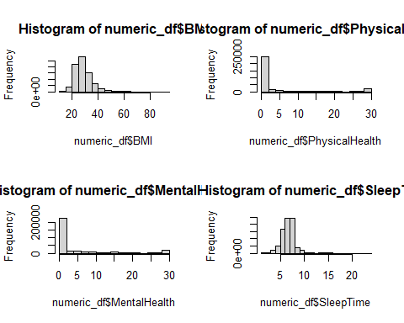
Histogram
We see that the BMI has a right skewed distribution
Many did not experience physical injury or illness
Many did not experience bad mental health
The SleepTime is approximately normally distributed

Slide 14
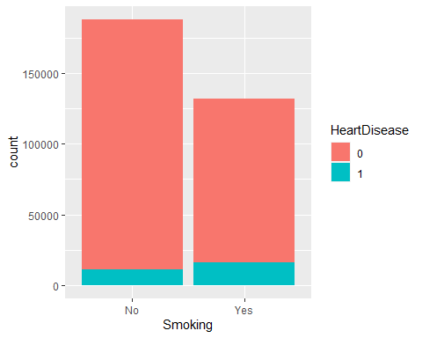

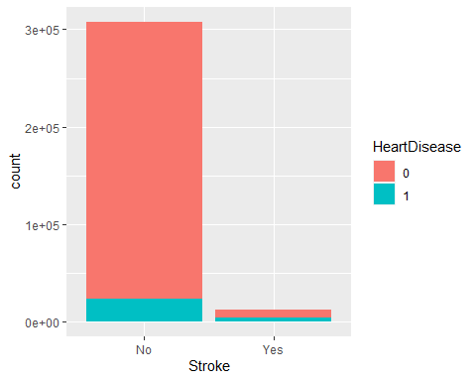
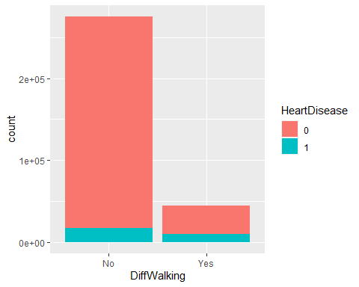
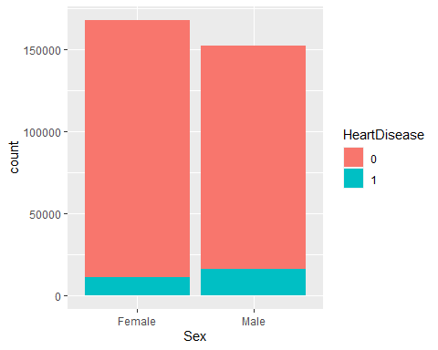

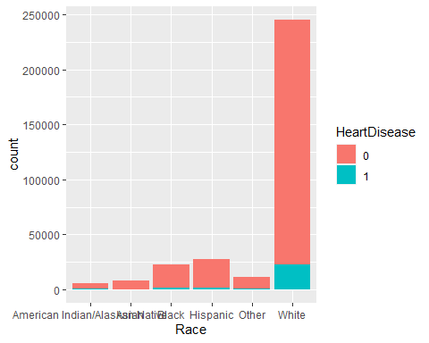
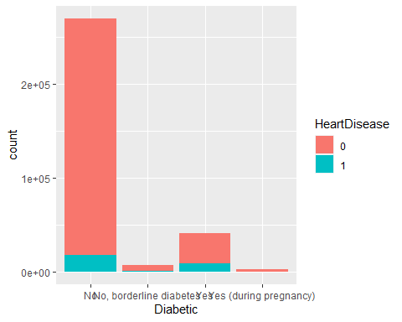
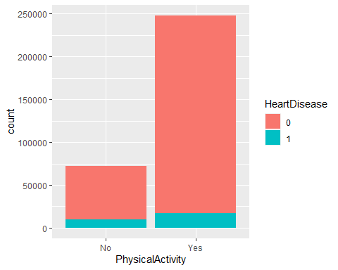
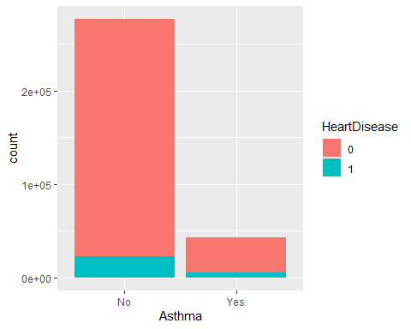
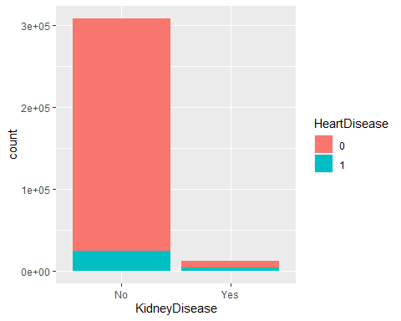
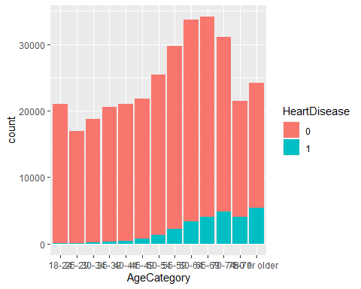
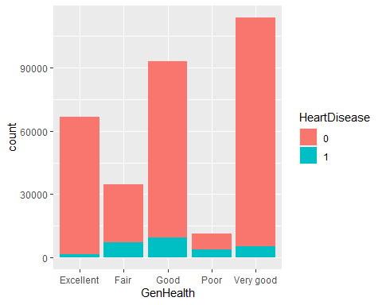
Stacked Bar Charts
In all the charts, we see that non-heart disease patients are higher than patients with heart disease.
A large proportion of patients not suffering from the risk factors, do not have heart disease
Occurrence of heart diseases are lower in younger population

Slide 15
Machine Learning
We predict the HeartDisease variable using the risk factors as independent variables
We split the data into 80% training and 20% test data
We constructed the below models:
Logistic Regression
Random Forest
Decision Tree
K Nearest Neighbours
Support Vector Machine

Slide 16
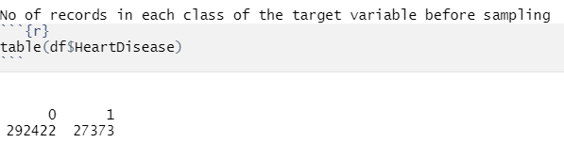
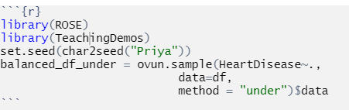
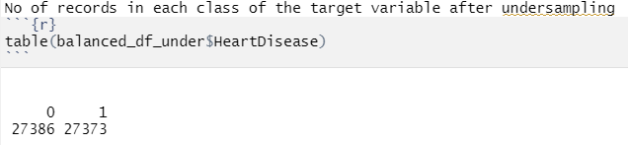
Sampling
Our dataset contains more number of non-heart disease records than ones with heart disease
In order to overcome this class imbalance, we performed under-sampling

Slide 17
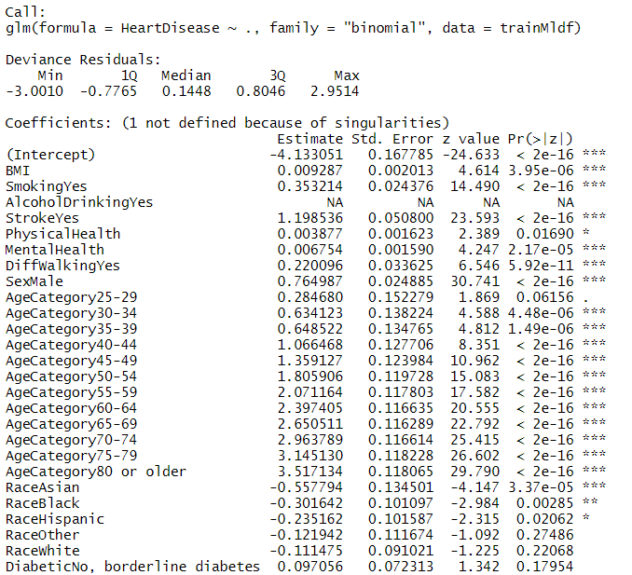
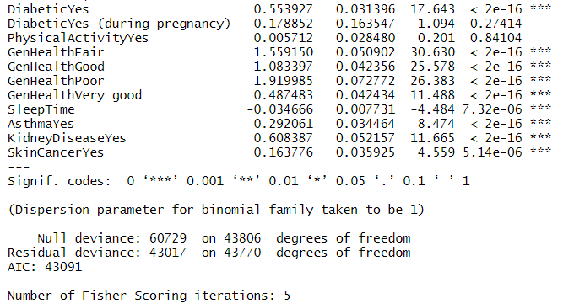
Logistic Regression

Slide 18
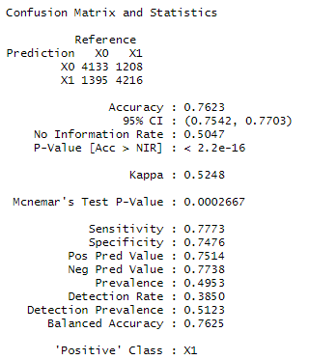
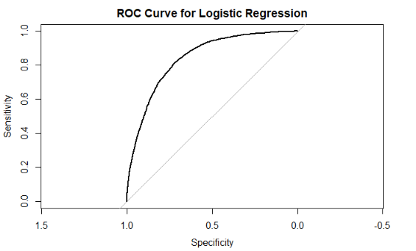
Performance

Slide 19
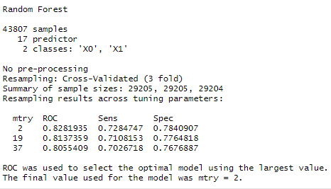
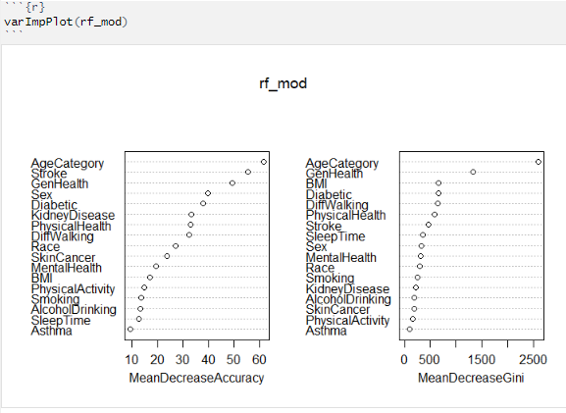
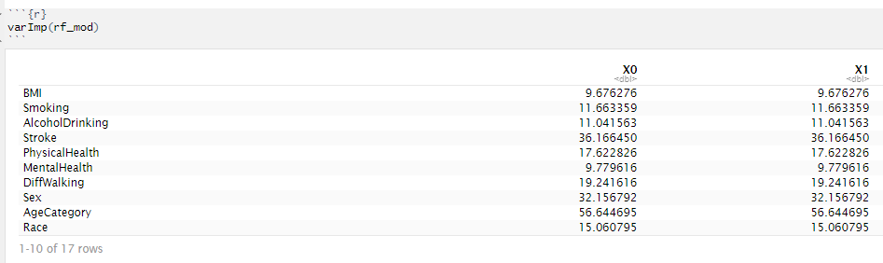
Random Forest

Slide 20
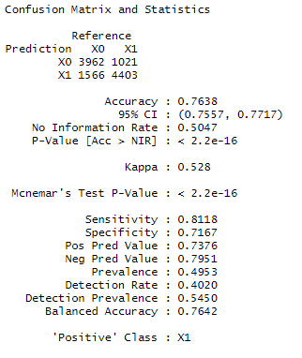
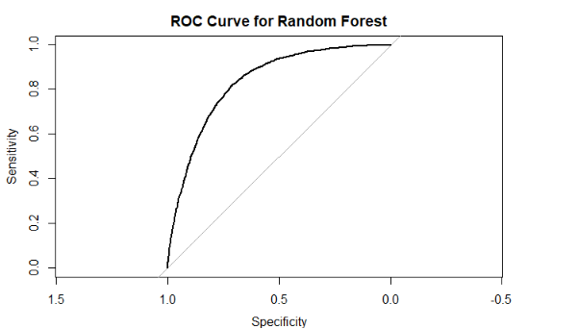
Performance

Slide 21
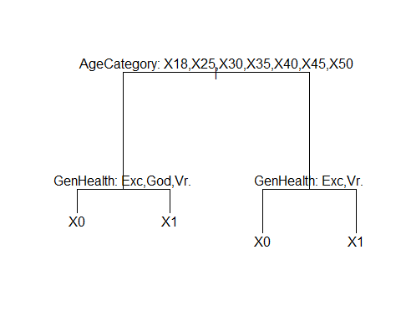
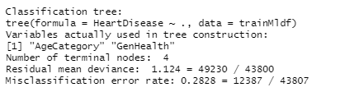
Decision Tree

Slide 22
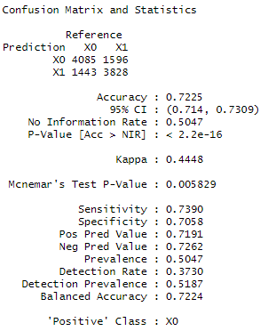
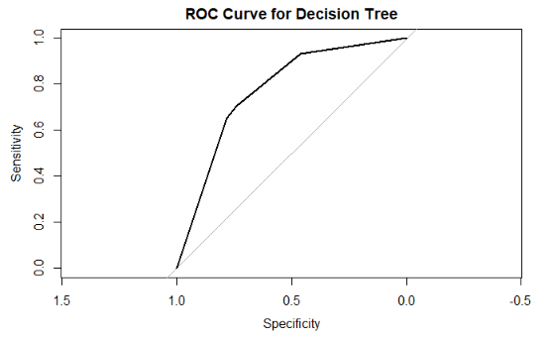
Performance

Slide 23
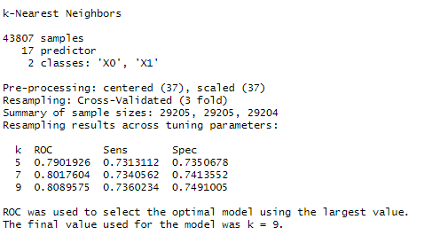
KNN

Slide 24
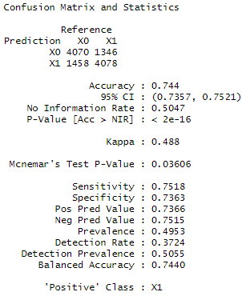
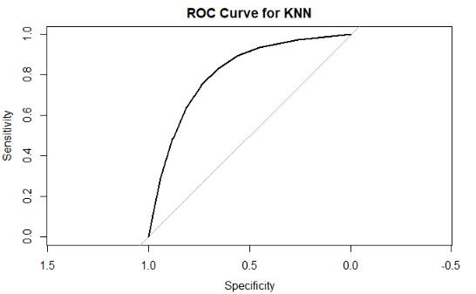
Performance

Slide 25
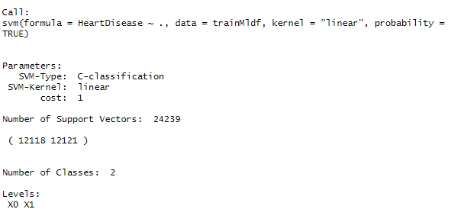
SVM

Slide 26
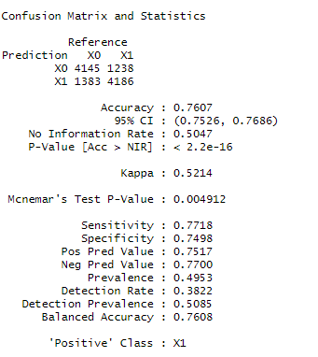
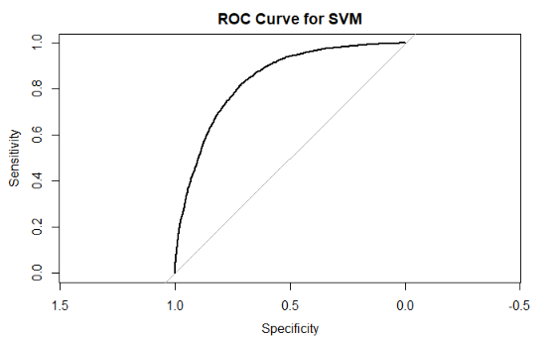
Performance

Slide 27
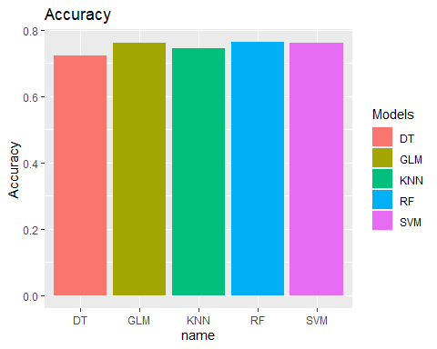
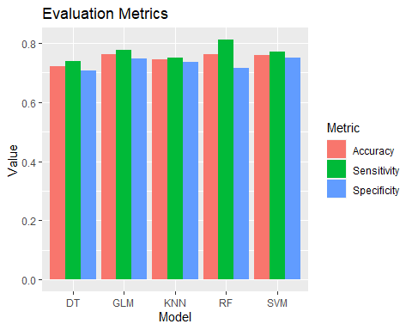
Performance Evaluation of the models
The accuracy of all the models are similar.
However, Logistic Regression, Random Forest and SVM have slightly higher accuracy.
When it comes to sensitivity, Random Forest performs the best

Slide 28
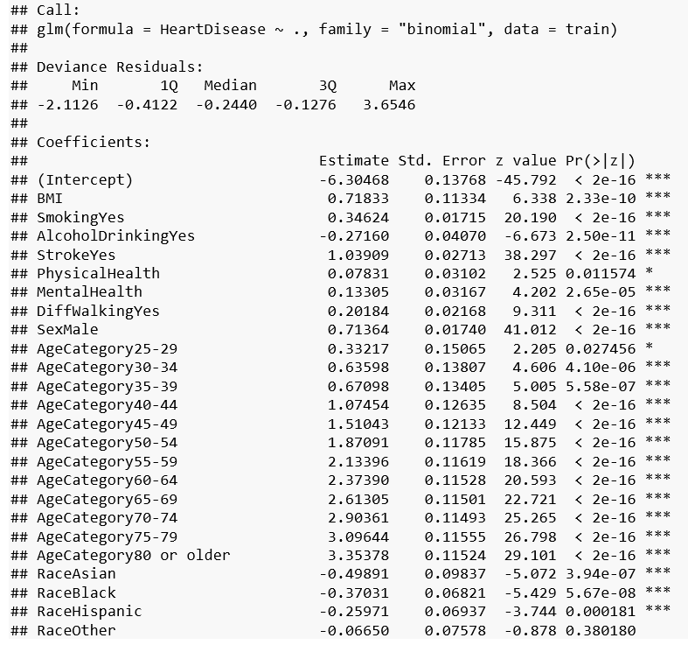
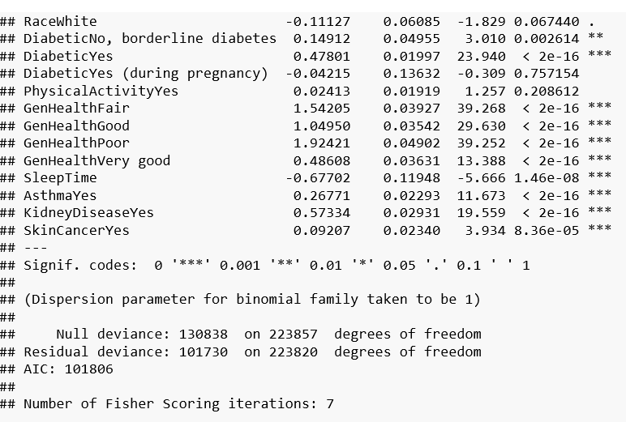
Caret library : Improved Logistic Regression model

Slide 29
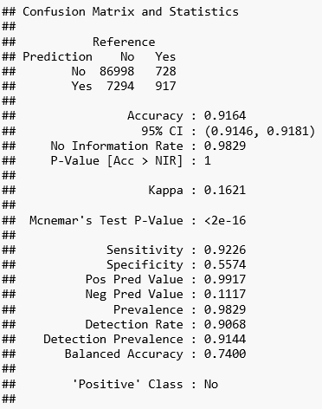
Performance

Slide 30
Thank you!

